Slide 1
Successful and Rapid Business Change: Operations-Led Transformation
Discussion Document
March 16th, 2005

Slide 2
Background and context
Introduction: This document was prepared by IBM Business Consulting Services for Gap Inc. to discuss potential focal areas to apply IBM’s approach for managing rapid operational change for business improvement

Slide 3
Discussion topics
Challenges in managing business change
Successful and rapid change: IBM Operations-Led Transformation Approach
Operations-led Transformation in action at Gap

Slide 4
There is a view in among major firms that most IT led transformation programs do not realize the expected benefits
Projects frequently promise rich rewards, yet 75% fail to deliver against original targets
The lack of a framework to track benefits is cited as the key reason that benefits did not emerge as planned
70% of companies have no formal justification process or post-implementation review process for IT investments
Through 2002, fewer than 25% of application projects will deliver hard, monetary benefits that exceed the cost of the implementation
Sources: Gartner; CIO Magazine

Slide 5
This was confirmed in a cross-industry, 2003 global study, which revealed that only 41% of organizations achieve targeted benefits
41%
37%
37%
19%
2%
4%
No benefits
Small number of
About half of
Majority of
All benefits
realized
benefits realized
benefits realized
benefits realized
realized
Organizations Achieving Benefits in IT Projects

Slide 6
Organization and people issues traditionally considered ‘soft’ are now understood to be ‘hard’ enablers of value creation opportunities
$1.3b
$12.6b
ILLUSTRATIVE CASE
$0.2b
$0.6b
High Margin
Retail Products
$0.4b
Retail
Clearing-
house
$0.3b
Outsource
Info.
Systems
$0.4b
Outsource
Admin.
Functions
$0.4b
Outsource
Distrib. Network
$8.9b
$0.1b
$8.9b
e-CRM
Procure
New Value
Purchase Power
Old Value
De-Capitalization Driven Benefits
Growth
Driven Benefits
E-Driven Benefits
Org & people
issues
Transform purchasing organization
Transform into customer centric organization
Assess operations/admin/IS orgs; outsource non-core processes
Develop organizational capability and performance measurements to manage outsourced relationships
Develop roles & responsibilities
Assess capabilities & identify gaps
Develop marketing & product development competencies
Leadership aligned to new business model
Organizational capability developed to support new business model
Notes:
THIS SLIDE BUILDS
That does not happen by itself – need to think thru the ability of the organization to deliver the benefits promised – unless these elements are thought thru in terms of the ability of the people to take action and create value, we will not get the benefits we are seeking

Slide 7
The cost of failed change can be significant
ILLUSTRATIVE CASE
$12.6b
$0.5b Lost
Implications of Failed Change
$0.5b Lost
$2.6b Lost
Employees not aware of org strategy & direction
Unclear change agenda
$3.7b
Potential Increase in Value
Falling customer satisfaction levels
Reduced employee satisfaction levels
Fewer new ideas
More complaints
Value Potential Lost
Symptoms
Shareholder value
$8.9b
$0.2b Lost
$8.8b
IT and admin services not responsive to users
Org silos prevent collaboration
Management resources diffused
Delayed realization of change benefits
New change issues
Incorrect risk mgmt assessment
Top team not aligned - failure to develop capability for new business model
Enterprise not customer focused
CONSEQUENCES
Failure to outsource; no stream of new products/ services
Delayed/Failed Change
Adverse organizational dynamics can reduce the NPV of change initiatives through delays in realizing benefits and underachievement of growth potential. Worse, the organization may never ultimately achieve target financial goals.
Notes:
Not only we won’t get benefits, may actually get NEGATIVE benefits
Issues like these directly affect the ability of the program to deliver the shareholder value commitments to the client
There is a direct link between change issues and NPV – Value is created or destroyed where decisions are made

Slide 8
Even with the best of intentions, projects and their planned benefits can go off course
Get the system in and working
(technical process focus)
Best intentions
Focus on
Benefits
Change fatigue
Wallet fatigue
Get the business benefits
(business focus)
Hard reality
Time
RECIPE FOR DISAPPOINTMENT:
STEP 1: Start with a strong focus on business benefits
STEP 2: Mix in change: in large quantities, until fatigue and high cost abound
STEP 3: Bake the lot, until interest and focus shifts away from business needs, toward technical/process needs
Notes:
There is the hope that if we continue to deliver the technical solution, things will come out fine – link between tech solution and benefits begins to fade – two reasons:
We get tired – key 3rd and 4th years
If things are not going as smoothly as we want, do we throw more money at it?

Slide 9
Retailers are not immune to these challenges
Enterprise applications, such as Merchandise Management Systems and PLM (e.g. Retek, MatrixOne, etc.) implementations often take longer, cost more, and deliver less business capability improvement than expected
“Silo-ed” IT applications and data repositories persist and inhibit the ability to access/share data within and across business functions
And yet… Retailers need fast, flexible, IT solutions to grow brands, and improve business performance

Slide 10
Gap International’s challenge in the C-to-C project does not appear to be appropriate for a traditional IT led process change initiative
Gap International’s business performance is lagging due to deficiencies in the merchandise assortment
To make more effective merchandising decisions (e.g grow sales & margins) Gap is moving merchants into the markets they serve (e.g. UK, Europe, Japan)
Batch driven systems won’t support in-country users because of time lags in batch processes
The merchant teams are moving with limited systems support, Planning will remain in SF and follow when systems can support them
Splitting the teams apart will leave merchandising without business services and present integration issues with the functional teams that remain in SF for the time being (e.g. Planning & Distribution)
Wielding a Retek hammer in this situation may lead to unsatisfactory results

Slide 11
Processes affected by the C-to-C project
Merchandising: Core Processes
I. Merchandise Management
II. Distribution & Logistics
Plan Assortment
Source Product
Maintain Vendor/Item
Perform Purchasing
Manage Price
Forecast Demand
Plan Inventory
Evaluate Product/Vendor Performance
Manage Import
Manage Inbound Logistics
Review item performance
Define department strategy
Define product mix
Define same product variations
Create product listing
Determine space plan
Develop product design
Create prototype
Research product requirements
Finalize product design
Determine make vs. buy
Plan production
Produce product
Create new item/vendor
Edit existing item/vendor
Delete existing item/vendor
Review recommended orders
Modify purchase quantities
Approve purchase order
Transmit purchase order
Manage open-to-buy
Receive order acknowledge-ment
Develop pricing strategy
Review existing product margins
Evaluate competitor pricing
Establish product pricing
Communicate price changes
Monitor pricing effectiveness
Analyze historical sales data
Evaluate season’s marketing plan
Analyze current stock level
Create forecasts
Commun-icate forecasts to organization
Adjust inventory levels
Compare forecast with actual
Analyze and plan merchandise
Create initial allocation
Manage allocations on receipt
Replenish and manage in-season
Manage slow moving stock
Manage end of season
Develop vendor scorecard
Collect vendor perform-ance data
Analyze vendor perform-ance
Analyze inventory position
Take appropriate action
Establish LOC
Clear customs
Pay duties/tax
Establish vendor standards
Schedule transport-ation to warehouse
Receive/QC goods
Manage waste
Slot product
legend
Move immediately
Move as systems will support
Move TBD

Slide 12
Discussion topics
Challenges in managing business change
Successfully managing change: IBM Operations-Led Transformation Approach
Operations-led Transformation in action at Gap

Slide 13
IBM has developed an approach for retailers to realize business benefits faster…
…with lower initial costs and lower risk to program success
IBM Operations-Led Transformation Approach…
Avoids long time lags between green-lighting a project and realizing business benefit
Delivers incremental process improvements through ‘lightweight’ application integration technologies that utilizes the current application environments
Reduces the risk associated with human factors and change management, because the business users are involved in the change process from ‘day one’
Major new applications can services be developed in parallel and delivered in a continuous improvement environment, as opposed to a ‘big bang’

Slide 14
What is Operations-Led Transformation?
Operations-Led Transformation (OLT) is an approach to business improvement initiatives focused on delivering tangible, measurable and sustainable benefits. It is a…
  Structured methodology for managing the organization through incremental changes to achieve breakthrough performance improvement
  A Repeatable process for rapid and continuous improvement and maximum return on investment
Technology is viewed as an enabler of performance improvement, not the focus of the initiative
Notes:
Context is, client said yes, now time to deliver against it
Structured methodology – literally hundreds in IBM – need performance consistency
Enabler ties to stakeholder stuff – talking to the right people – changing ownership and accountability inside organizations themselves

Slide 15
Work steps of an OLT project
Step One: Understand the concerns of the business
  What is the business strategy?
  What are the business objectives and how are they measured?
Step Two: Understand how the business currently works to achieve those goals (Business Operations Modeling)
  What is the business producing? (What are the key business documents? What do they contain?)
  How are they producing it? (How are the key business documents passed from one role player to the next?)
  What are the performance gaps? (Where are the breakdowns in business effectiveness and efficiency?)
Step Three: Understand how IT can enhance information operations to support improvements in business performance (Information Operations Modeling)
  What are the key information sources?
  What are the key information processes?
  How do business users access and input information in the context of the processes?
  What metrics are needed to evaluate the performance of the processes?
Step Four: Enhance business operations support
  Develop lightweight IT solution artifacts to improve the efficacy of existing core IT applications
  Deploy solution with pilot user group
  Refine solution artifacts
  Scale solution to wider user groups
Step Five: Continuous process improvement
  Extend solution artifacts to include users in related business functions
  Monitor business performance, and identify additional improvement opportunities
  Repeat Steps Three & Four (Some improvements at this point may require new IT applications)

Slide 16
Benefits of the OLT approach
Business improvements initiatives remain closely tied to the strategy and objectives of the business
  As the targets change, the business improvement projects follow in lock-step
Information Operations models are directly tied to Business Operations models
  Direct translation of business operations into IT solution models significantly reduces the time-to-value for IT projects by shortening the development cycle (weeks, not months)
Enhanced Information Operations are developed on a Service-Oriented technology platform
  Greater dependence on existing IT systems to create solutions
  Focus on quick turnaround, lightweight application development
  Enables access to resources across geographical boundaries
  When new core application implementation is required, business need will be better defined and improvements realized more quickly

Slide 17
Discussion topics
Challenges in managing business change
Successfully managing change: IBM Operations-Led Transformation Approach
Operations-led Transformation in action at Gap

Slide 18
Business Objective: Improve Labor Efficiency and Utilization
OLT in action at Gap
Business Process: Distribution Flow Forecasting
Merchandise distribution utilizes large pools of labor resources in the DCs and Stores
Flow forecasting at GAP provides Distribution Centers (DC) and Stores the basis for resource planning
In current state, flow forecasting teams at GAP…
  work entirely on spreadsheets with only little access to both actual historical data and the company wide sales forecasts
  have no means to properly manage and share forecasts within the product divisions
  do not evaluate the quality of their forecast
  rely entirely on manual execution of the business process
Ineffective flow forecasting reduces resource planning efficiency and utilization of labor resources
In addition, allocating product to stores where it is under-productive erodes net margins… measuring forecast accuracy could lead to improved efficacy

Slide 19
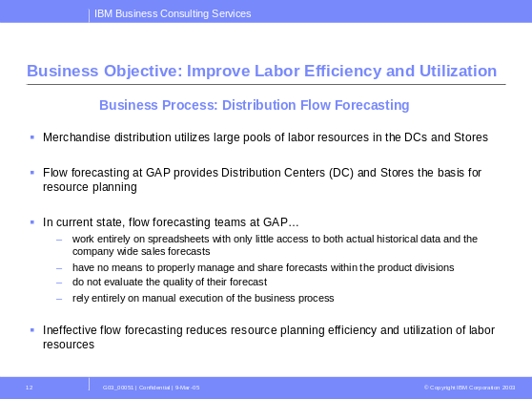
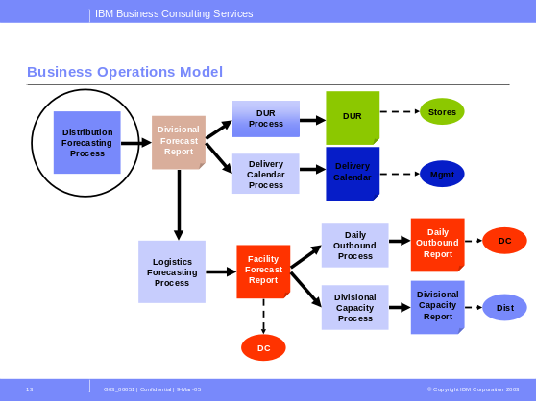
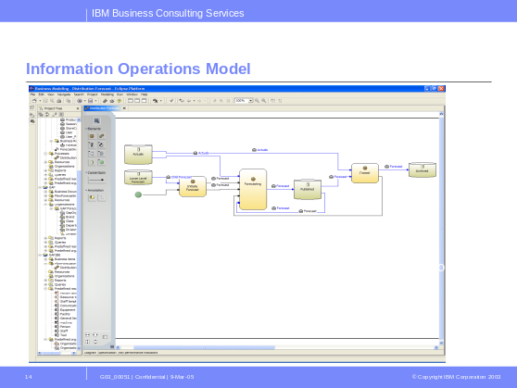
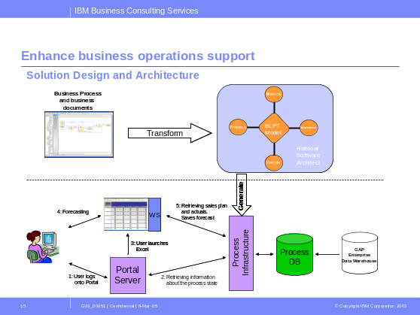
Key activities of the Distribution Flow Forecast Project
Step One: Understand the concerns of the business
(elapsed duration 2 work days)
Step Two: Understand how the business currently works to
achieve it’s goals (elapsed duration 5 work days)
Step Three: Understand how IT can enhance information operations to support improvements in business performance (elapsed duration 20 work days)
Step Four: Enhance business operations support (elapsed duration 30 work days)

Slide 20
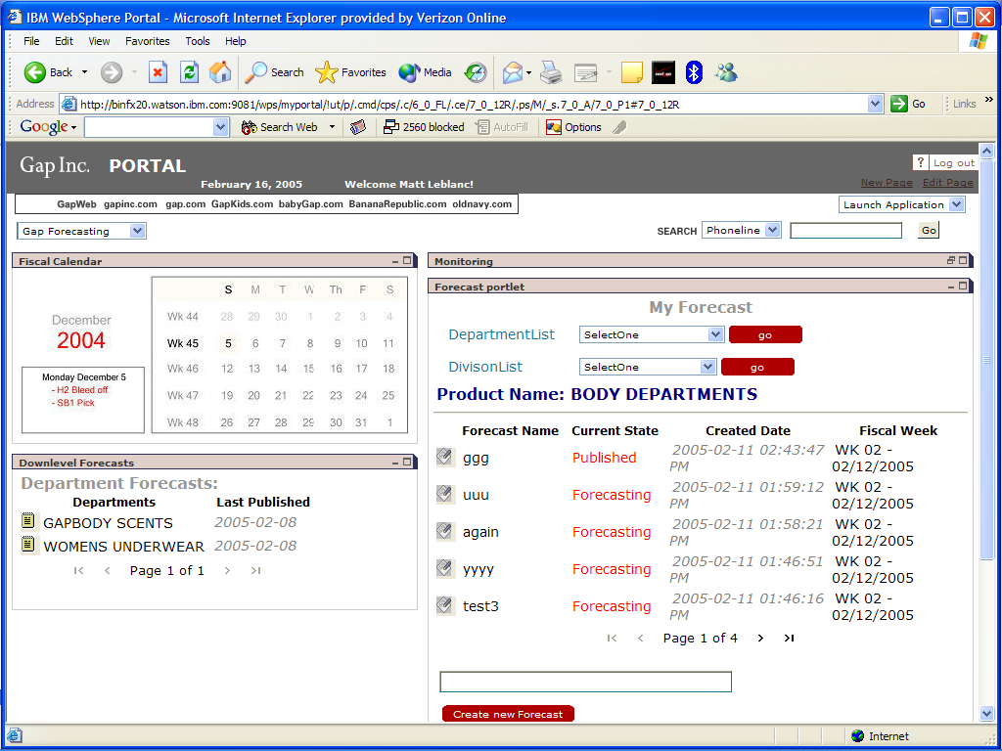
Release 1 (working pilot) : Gap Kids Distribution Flow Forecasting Tool (achieved in 57 work days)
Distribution flow forecasts are now accessed thru a web portal
Data pull from the data warehouse is now automated
Excel spreadsheets still used as the decision support tool
Automated data push to target systems when the spreadsheet is closed
Flow forecast rollup across division is now integrated/automated
Forecast accuracy can be measured/monitored to achieve business improvement targets

Slide 21
Business Benefits from Flow Forecasting Project
Optimize the flow forecasting business process…
  by providing the right data at the right time
  by supporting various forecasters with different responsibilities to collaborate and to share forecast related information
  by managing forecast data consistently
  by monitoring the quality of the forecast by evaluating relevant KPI’s
Process Effectiveness: Improve the quality of the forecast
  DC’s plan within a 15% bracket off the monthly forecast for a given product. (i.e. forecasters can adjust they weekly forecast up to 15% till end of the month to account for forecast inadequacies)
  Reducing the variability bracket to 10% will save Gap Kids approx $1M in labor cost
Process Efficiency: Streamline and automate the business process resulting in significant reduction in time and resources
“Typically we need a year to see the kind of benefits this project has delivered in two months” – Gap Business Leader on the Distribution Flow Project

Slide 22
Additional benefits
Business Agility
  Reducing the gap between Business Requirements and IT solutions delivered
  Reducing the process design and development time
Process Improvement
  Increasing the effectiveness of the business process prior to implementation
  Reduce errors associated with manual processes
  Providing a common process framework
  Horizontal Process Integration across functional silos
Process Visibility
  Monitoring Key Performance Indicators
  Notifying process owners of changes in KPIs and process exceptions
  Correlating and managing complex events across processes & systems
Process Adaptability & Evolution
  Closing the loop: model, integrate, monitor, adapt
  Evaluate multiple variants of the process in real-time & promote high performing ones

